Slide 2
Pipelining Hazards
Structural, Data and Control Hazards

Slide 3
Pipeline Hazards
There are situations, called hazards, that prevent the next instruction in the instruction stream from being executing during its designated clock cycle. Hazards reduce the performance from the ideal speedup gained by pipelining. There are three classes of hazards: –
Structural Hazards: They arise from resource conflicts when the hardware cannot support all possible combinations of instructions in simultaneous overlapped execution.
Data Hazards: They arise when an instruction depends on the result of a previous instruction in a way that is exposed by the overlapping of instructions in the pipeline.
Control Hazards: They arise from the pipelining of branches and other instructions that change the PC

Slide 4
Structural Hazards
When a machine is pipelined, the overlapped execution of instructions requires pipelining of functional units and duplication of resources to allow all possible combinations of instructions in the pipeline.
If some combination of instructions cannot be accommodated because of a resource conflict, the machine is said to have a Structural Hazards

Slide 5
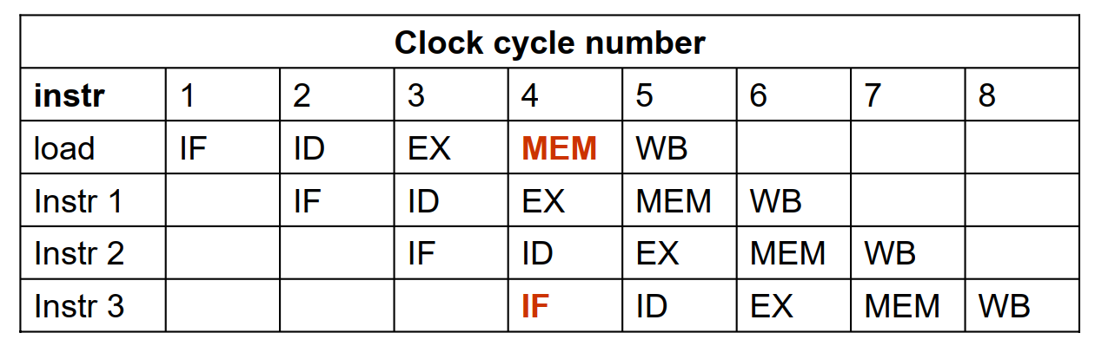
Example
A machine has shared a single-memory pipeline for data and instructions. As a result, when an instruction contains a data-memory reference (load), it will conflict with the instruction reference for a later instruction (instr 3)

Slide 6
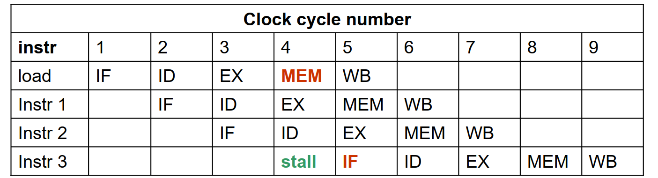
Solution(1/2)
To resolve this, we stall the pipeline for one clock cycle when a data-memory access occurs. The effect of the stall is actually to occupy the resources for that instruction slot. The following table shows how the stalls are actually implemented.

Slide 7
Solution(2/2)
Another solution is to use separate instruction and data memories.
ARM is use Harvard architecture, so we do not have this hazard

Slide 8
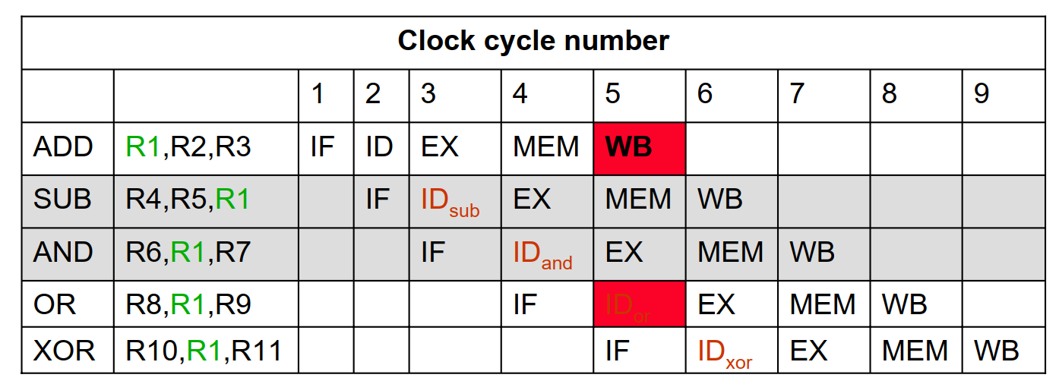
Data Hazards
Data hazards occur when the pipeline changes the order of read/write accesses to operands so that the order differs from the order seen by sequentially executing instructions on the unpipelined machine.

Slide 9
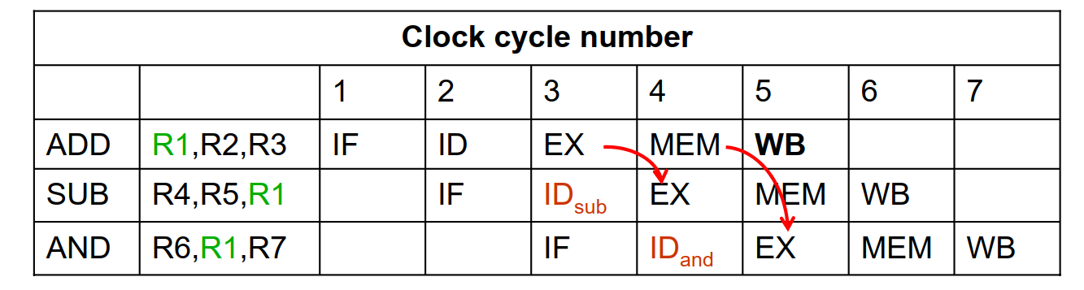
Forwarding
The problem with data hazards, introduced by this sequence of instructions can be solved with a simple hardware technique called forwarding

Slide 10
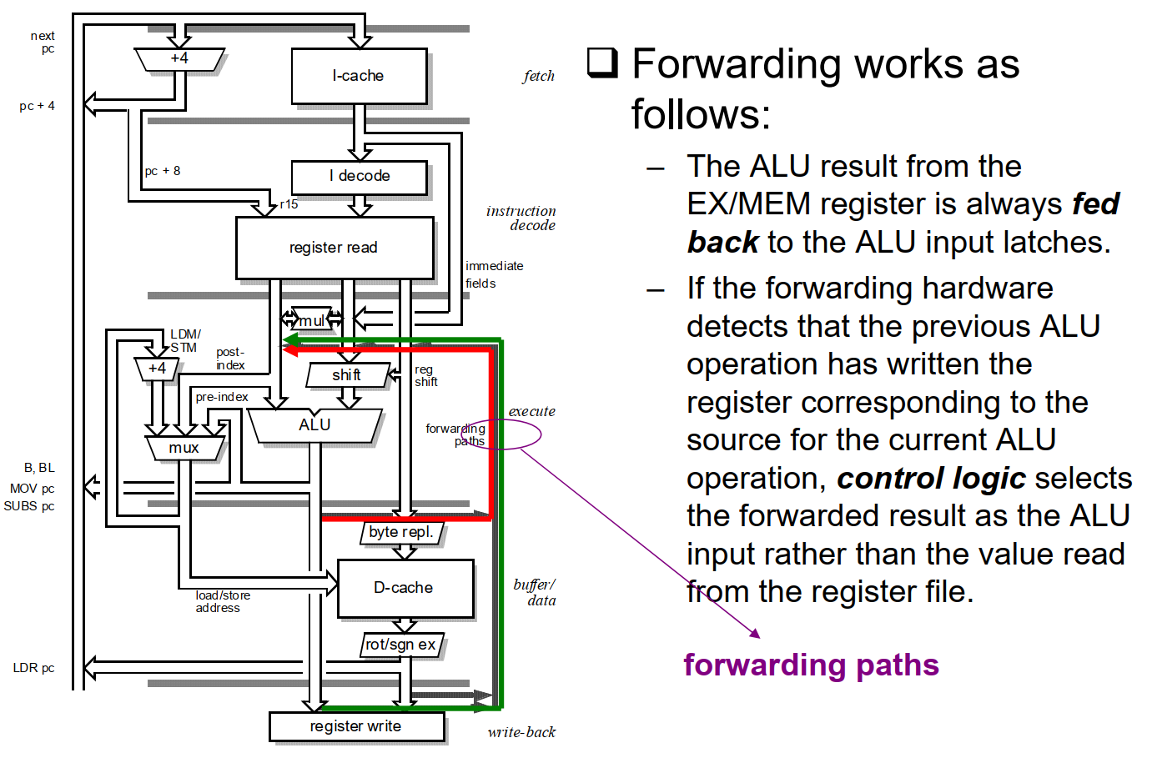
Forwarding Architecture

Slide 11
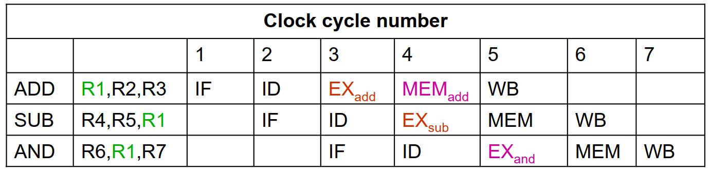
Forward Data
The first forwarding is for value of R1 from EXadd to EXsub. The second forwarding is also for value of R1 from MEMadd to EXand. This code now can be executed without stalls.
Forwarding can be generalized to include passing the result directly to the functional unit that requires it: a result is forwarded from the output of one unit to the input of another, rather than just from the result of a unit to the input of the same unit.

Slide 12
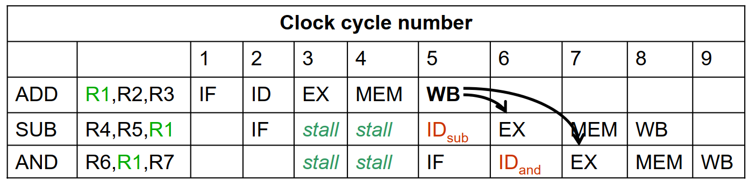
Without Forward

Slide 13
Data Forwarding
Data dependency arises when an instruction needs to use the result of one of its predecessors before the result has returned to the register file => pipeline hazards
Forwarding paths allow results to be passed between stages as soon as they are available
5-stage pipeline requires each of the three source operands to be forwarded from any of the intermediate result registers
Still one load stall LDR rN, […] ADD r2,r1,rN ;use rN immediately – One stall – Compiler rescheduling

Slide 14
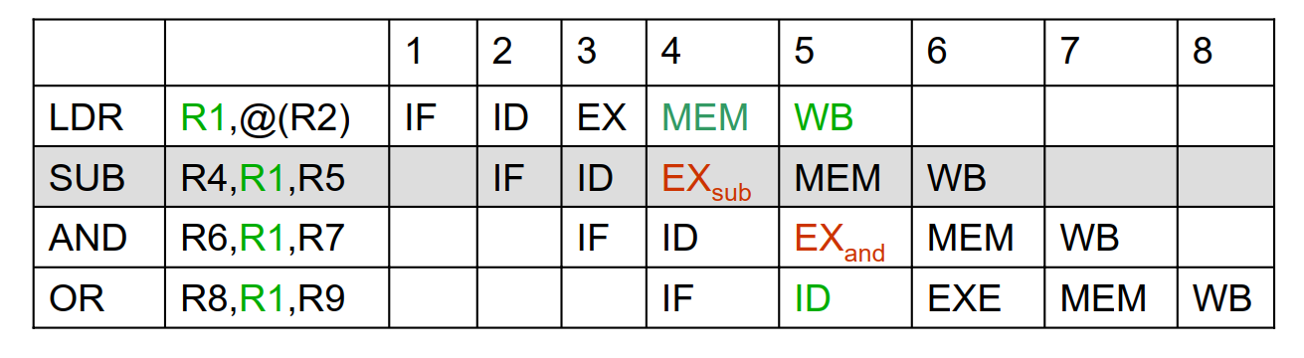
Stalls are Required
The load instruction has a delay or latency that cannot be eliminated by forwarding alone.

Slide 15
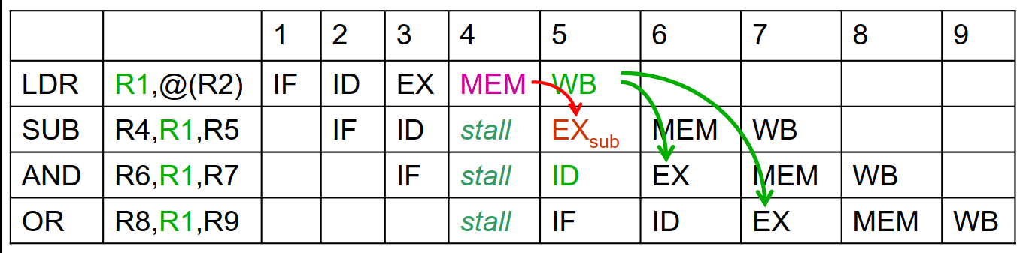
The pipeline with one stall
The only necessary forwarding is done for R1 from MEM to EXsub.

Slide 16
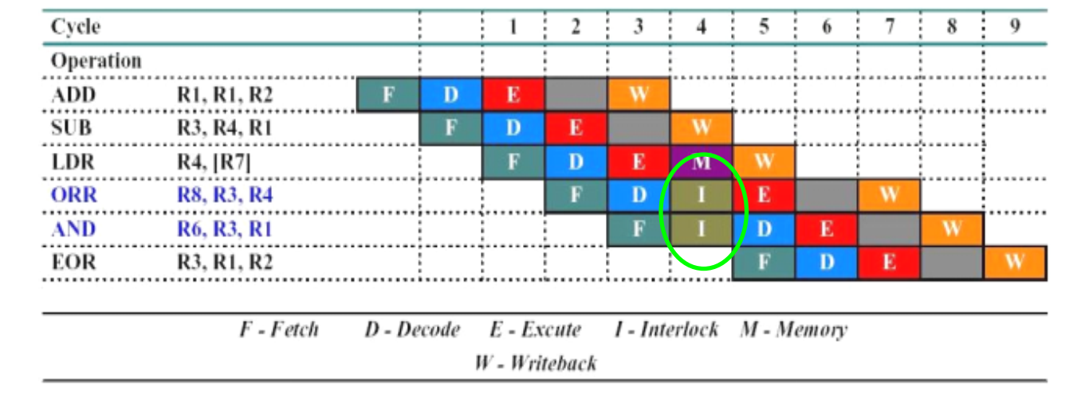
LDR Interlock
In this example, it takes 7 clock cycles to execute 6 instructions, CPI of 1.2
The LDR instruction immediately followed by a data operation using the same register cause an interlock

Slide 17
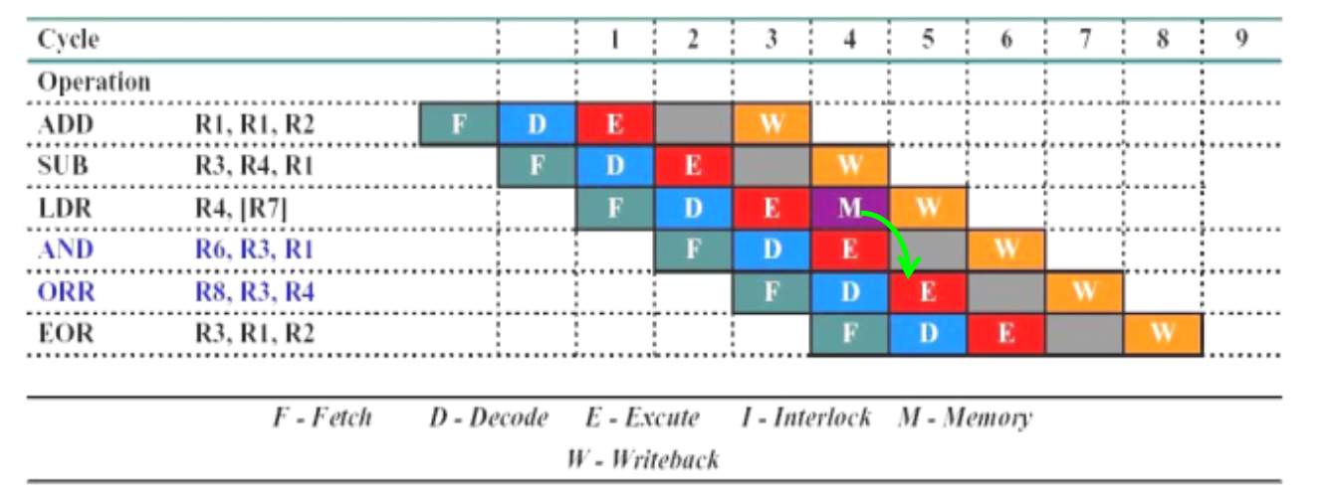
Optimal Pipelining
In this example, it takes 6 clock cycles to execute 6 instructions, CPI of 1
The LDR instruction does not cause the pipeline to interlock

Slide 18
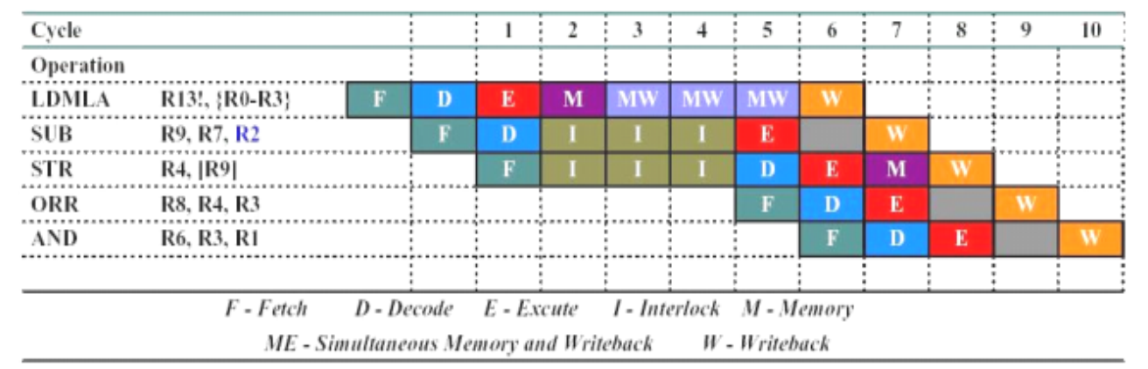
LDM Interlock (1/2)
In this example, it takes 8 clock cycles to execute 5 instructions, CPI of 1.6
During the LDM there are parallel memory and writeback cycles

Slide 19
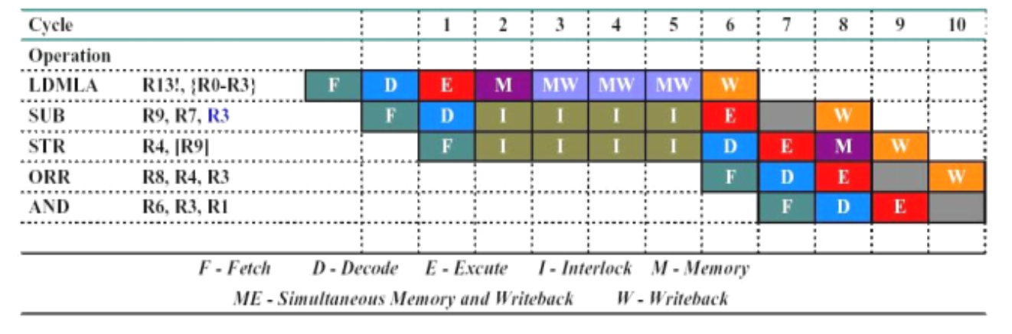
LDM Interlock (2/2)
In this example, it takes 9 clock cycles to execute 5 instructions, CPI of 1.8
The SUB incurs a further cycle of interlock due to it using the highest specified register in the LDM instruction

Slide 20
Thank You!

